Slide 1
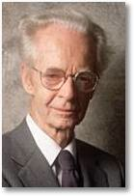
An RFT Account of Interdisciplinary Case Coordination: Building the Value of CBS-ABA Currency
Thomas G. Szabo, PhD., BCBA
Florida Institute of Technology

Slide 2
The Discrimination Training Procedure
1) Begin with deictic framing
“I notice myself doing this… and you doing…”
2) Encourage coordinative framing to generate empathy
- “We really are a lot like each other, aren’t we?!?”
3) Use hierarchical framing to gain deeper perspective and promote action in service of shared values
- “The key here is Jimmy’s progress. Let’s focus on that.”
Notes:
I’m going to give you everything you need to know about my talk right up front. Here it is, in a nutshell. Read this and you really don’t need to stay for the rest! Okay, well that just seems a little cold, since you came all the way here to the Windy City to hear this talk, so let me see if I can warm things up a bit.

Slide 3
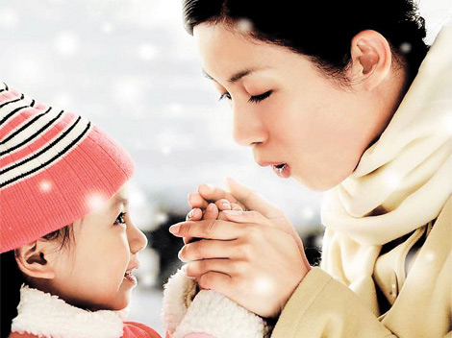

Slide 4
Coordination with Other Professionals
The BACB (2012) published guidelines for health plan coverage of ABA services for Autism Spectrum Disorder
Consultation and care coordination is a primary focus
“Tx goals are most likely to be achieved when there is a shared understanding and coordination among all healthcare providers and professionals” (BACB, 2012, p. 36)

Slide 5
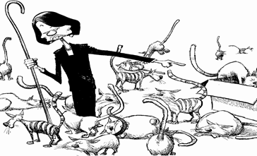
Hmmm…

Slide 6
Why is this so difficult?
Differences in theoretical orientations & professional styles
Treatment eclecticism
Unproven, ineffective treatments prescribed
Limited resources
Competition
BCBA bx is no different from that of others
We are not objective or neutral
BCBAs operate under conditions of deprivation & aversive stimulation

Slide 7
Problem-Solving Bx
Under conditions of deprivation & aversive stimulation,
We engage in problem-solving bx
In which we have no immediately available bx that can resolve the condition
We use verbal skills to perform in ways that sticks, stones, mortar, and artillery might otherwise function

Slide 8
An Important Note
The focus on external variables to explain bx has led to many advances
It has also led to some conceptual difficulties within RB
Specifically, Skinner at times wrote of private events as bx to be explained
And at other times as by-products of overt responding

Slide 9
Conceptual Quandary
These conceptual difficulties can be resolved by an appeal to the truth criterion of the philosophy of Radical Bxism: effective action
If it is useful for us to view private events as bx because doing so affords us greater tools for action, then let us do so
In the present context, we deal with psychological functions in IDT mtgs. and find utility in describing this form of private event as behavior
To be addressed
Ultimately, our interest is in measuring socially significant overt bx

Slide 10
Uncooperative Social Negative/Positive(?) Bxs
Overt fight
Dominating
Talking over others
Interrupting
Ignoring
Overt flight
People pleasing
Under-scheduling
Double-booking
Passive-aggressive

Slide 11
Uncooperative Social Negative/Positive(?) Bxs
Overt fight
Dominating
Talking over others
Interrupting
Ignoring
Overt flight
People pleasing
Under-scheduling
Double-booking
Passive-aggressive
Covert fight
Evaluating
Judging
Comparing
Dismissing
Covert flight
Tuning out
Rationalizing others’ bx
Rationalizing own bx
Justifying

Slide 12
Social Negative/Positive(?) Bxs
Overt fight
Dominating
Talking over others
Interrupting
Ignoring
Overt flight
People pleasing
Under-scheduling
Double-booking
Passive-aggressive
Covert fight
Evaluating
Judging
Comparing
Dismissing
Covert flight
Tuning out
Rationalizing others’ bx
Rationalizing own bx
Justifying
Notes:
Not because of any interest in changing those bxs - I don't think we can, at least at present, we’ll have difficulty measuring that directly..
I'm a bx analyst, and for the most part, my position is that if we change the contingencies that affect overt bx, we change overt bx. When that happens, we have a probability of changing covert bx too.
But sometimes that's very challenging. In IDTs, we cannot always control the contingencies that affect others’ bx. And in these situations, when there's a very difficult team that has had difficulties in the past, I’d suggest another strategy.
A growing number of RFT lab and applied studies suggest that acknowledging unwanted private events without trying to change or eliminate them increases the likelihood of transforming their functions and altering the contextual control over them. This alters the environment in which new classes of covert behavior that are more conducive to sustainable, socially significant cooperative bx may emerge.
… … …
Increasing the extent, flexibility, and fluency of relational frames, relational networks, relating relations, relating relational networks, the transformation of functions, and contextual control over each of these, should impact positively on a variety of standard measures of human language and cognition.

Slide 13
Learning This Repertoire
Accounting for the formation of this repertoire is useful toward
Capturing its operant origins
Designing effective, efficient interventions
For building more cooperative team behaviors
Notes:
That will end unnecessary feuding

Slide 14
These topographies are learned in the same way that we learn the primary verbal operants
We do something
We learn to tact what we are doing
We learn to speak without uttering any words
We think
Discriminate
Evaluate
Judge
Compare & contrast
Dismiss
Attend elsewhere (tune others out)
Rationalize
Justify
Notes:
We wouldn’t ascribe these functions to the behavior on non-verbal organisms. We say the organism learns to respond to the discriminations in the environment. But verbal bx changes all that and makes possible a spectrum of covert responding that is occurring in the environment and in relation to what is going on in the environment, but is more inaccessible, and therefore more challenging for science to effectively predict and control.

Slide 15
Relational Framing
Relational responding involves
learning stimulus relations
That have no formal or topographical matching
Are not directly trained
Are contextually controlled
Can be arbitrarily applied
Transforms the stimulus functions of events
Framing means categorizing by relation

Slide 16
Relational Framing
Categorizing by relation:
Coordination
Comparison
Distinction
Opposition
Hierarchy
Temporality
Causality
Deictic
I-HERE-NOW and YOU-THERE-THEN

Slide 17
Framing and Problem-Solving
In the context of deprivation and aversive stimulation,
Relational responding by way of
Comparison, distinction, opposition, etc.
Quite naturally extends direct conditioning
In ways that in the past resulted in protecting the self and affiliate group
Our profession
The client we care for (e.g., child with autism)

Slide 18
Direct Conditioning
Well-meaning BCBA Phil
Well-meaning OT Sally

Slide 19
Direct Conditioning

Slide 20
Direct Conditioning

Slide 21
Direct Conditioning

Slide 22
Indirect, Relational Conditioning
Well-meaning BCBA Phil
Well-meaning OT Sally
Evaluating
Comparing
Judging
Dismissing
Tuning out
Rationalizing others’ bx
Rationalizing own bx
Justifying

Slide 23
Countercontrol
Operant bx both controls and is controlled by the environment
Countercontrol counters or at least reacts to the control exerted by another party (Skinner 1953)
Bx that generates countercontrol by others may be effective in the short run, but ineffective in the long run
“In a situation where someone is managing the bx of others, the emergence of countercontrol suggests that improved management contingencies are necessary” (Johnston, 2014, p. 173)

Slide 24
Subtle Behavior is Difficult to Address w/ Contingency Management
However, BCBAs are usually not positioned to manage contingencies in IDTs
BCBAs can practice leadership during IDTs (Bailey & Burch, 2010) by:
Looking for cues from those in charge
Respecting organizational practices
Reinforcing the bx of others immediately upon entering the room
Practicing conventional pleasantries
Getting to the business at hand
Starting & ending on time
Reinforcing participation of others
Active listening (eye contact, rephrase what you heard)
Validating the concerns that underlie what others say
Still, every so often (very often)…

Slide 25
Direct Conditioning

Slide 26
Indirect, Relational Conditioning
Well-meaning BCBA Phil
Well-meaning OT Sally
Evaluating
Comparing
Judging
Dismissing
Tuning out
Rationalizing others’ bx
Rationalizing own bx
Justifying

Slide 27
Teaching BCBAs to Discriminate Their Own Relational Responding & That of Others
Discrimination training can involve noticing overt responses as well as thoughts, memories, and emotions with
Curiosity
Openness
Ask learner to plot them on a grid
Self-discrimination → Deictic distancing
“Helicopter view”

Slide 28
The Discrimination Training Procedure
1) Begin with deictic framing
Helicopter view; distancing to begin discrimination
2) Encourage coordinative framing to generate empathy
3) Use hierarchical framing to gain deeper perspective and promote action in service of shared values

Slide 29
1) Suggest Deictic Framing As Useful to the Team
Helicopter View
I, there, then
Sally, there, then
Deictic
Deictic

Slide 30
2) Encourage Coordinative Framing
Deictic/Coordinative Framing → Empathy
I, there, then
Sally, there, then
Coordination
Notes:
It may also be that I don’t know how Sally is feeling and in framing this way, I discover I really have no clue and then I want to ask to find out… but in general, when I sense that there is a lot of emotion, even if I can’t tact what it is, I can ask and we can share in our both experiencing a lot of emotion…

Slide 31
3) Use Hierarchical Framing
To Promote Behavior in Service of Shared Values
Our working together is
important, but only in the
context of Jimmy learning
to communicate his needs.
Jimmy = a shared value
Lil Jimmy
Hierarchical Framing
Notes:
Our working together is important, but only in the context of Jimmy

Slide 32
3) Use Hierarchical Framing
To Promote Behavior in Service of Shared Values
Our working together is
important, but only in the
context of Jimmy learning
to communicate his needs.
Jimmy = a shared value
Lil Jimmy
Hierarchical Framing
Notes:
Sally’s bx can go in any number of directions, but your bx is under the control of values you share with her. Hierarchical, coordinative, and deictic framing allow you to focus on what matters long term to you both, rather than on what you want or what she wants in the short term.

Slide 33
3) Use Hierarchical Framing
To Promote Behavior in Service of Shared Values
Our working together is
important, but only in the
context of Jimmy learning
to communicate his needs.
Jimmy = a shared value
Lil Jimmy
Hierarchical Framing

Slide 34
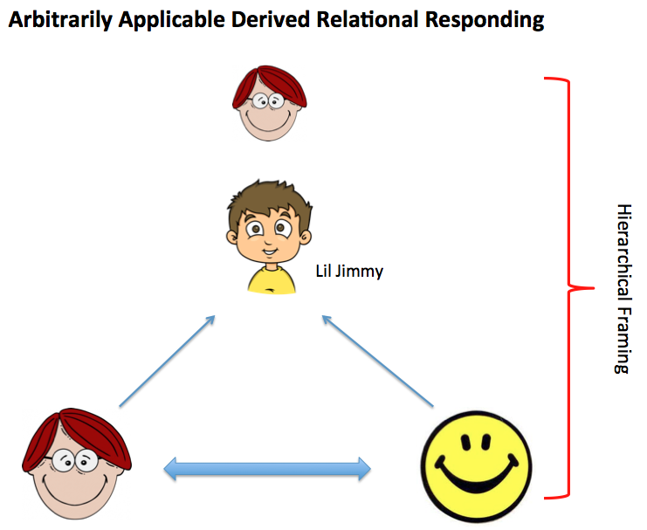
So, Is all this DERIVING
You crazy yet?

Slide 35
The Discrimination Training Procedure
1) Deictic framing
Helicopter view; distancing to begin discrimination
2) Coordinative framing to generate empathy
3) Hierarchical framing to gain deeper perspective and promote action in service of shared values

Slide 36
A Simple Format: Deictic Framing
“Guys, I want to take a moment before we begin.
I know some of you are thinking about the last meeting we had
Others of you are worried about getting home to watch the Super Bowl…
And I want to just publically observe that right now, here with you all, I’m feeling a little nervous. Excited at the opportunity we have to help Jimmy, but nervous.

Slide 37
A Simple Format: Coordinative Framing
I’m betting I’m not alone in feeling that way
Anyone else?
Most of us feel a bit anxious, maybe scared too, and excited with the possibilities when getting together with professionals from other fields
These meetings are stressful and I want to just acknowledge that we all experience these emotions and thoughts…
We’re all swimming in the same soup

Slide 38
A Simple Format Hierarchical Framing
Ultimately, we’re all here for Jimmy
So I’m going to make a public commitment to you, and ask you all if you might be willing to do the same
My commitment is to notice the jargon that comes from my field that I know and think everyone should know
But in fact nobody knows but me
And check all that at the door
I hope we can all agree, jargon has no place here

Slide 39
A Simple Format Hierarchical Framing
And I also want to publically self-disclose:
I have an agenda:
To get hours of paid time allotted to my services, and that’s important to me
AND Jimmy is even more important
I wonder if we could all take a moment to privately reflect on our agendas
And important as all that is,
Can we commit to working with each other to find the very best options for Jimmy?

Slide 40
A Simple Format Hierarchical Framing
This is a great team – everyone here’s got heart
With Jimmy’s interests out there in front of us, let’s get down to it
Who’d like to begin?

Slide 42
The Discrimination Training Procedure
1) Begin with deictic framing
“I notice myself doing this… and you doing…”
2) Encourage coordinative framing to generate empathy
- “We really are a lot like each other, aren’t we?!?”
3) Use hierarchical framing to gain deeper perspective and promote action in service of shared values
- “The key here is Jimmy’s progress. Let’s focus on that.”

Slide 43
Questions? Comments?
THANK YOU!
tszabo@fit.edu

